Slide 1
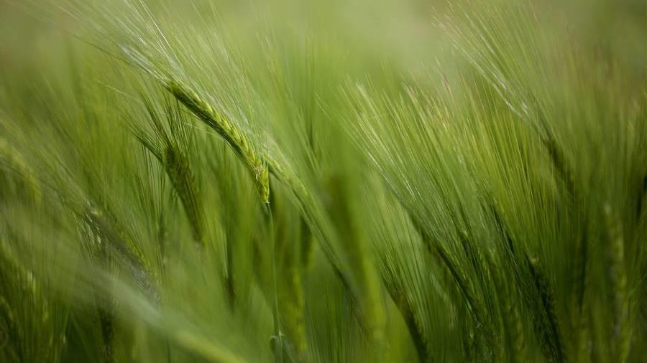
Crop Recommendation Model
Saumya Gunawardana
#196​​

Slide 2

Introduction
Yield of crops are highly dependent on environment conditions
Data gathered on link between those parameters and the best yielding crop can be used to develop an ML model
ML can be used to reduce the crop failures and to help the farmers to take informed decisions on best suitable crop

Slide 3
Data
N
Humidity
Nitrogen level of soil
humidity of the environment
P
Ph
Phosphorus level of soil
pH level of soil
K
Rainfall
Potassium level of soil
rainfall to the region
Parameters of the dataset
Temperature
Label
temperature of the environment
recommended crop based on the conditions
rice | mango
maize | grapes
chickpea | watermelon
kidneybeans | muskmelon
pigeonpeas | apple
mothbeans | orange
mungbean | papaya
blackgram | coconut
lentil | cotton
pomegranate | jute
banana | coffee

Slide 4
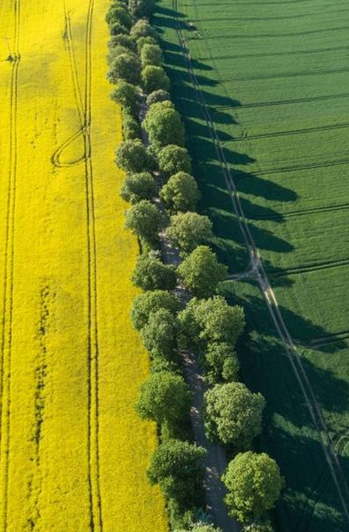
Methodology : Key steps
Data Preprocessing
Record count
Remove blank records
Dataset rearrangements
Machine Learning Models
Logistic Regression Model
Decision Tree Classifier
Random Forest Classifier
Comparing Models
Accuracy
Precision
Recall
F1 Score

Slide 5




MODEL Results
accuracy
precision
recall
f1_score
Logistic Regression | 0.957576 | 0.958339 | 0.957576 | 0.957889
Decision Tree | 0.869697 | 0.828091 | 0.884874 | 0.831863
Random Forest | 0.992424 | 0.994172 | 0.991883 | 0.992312

Slide 6
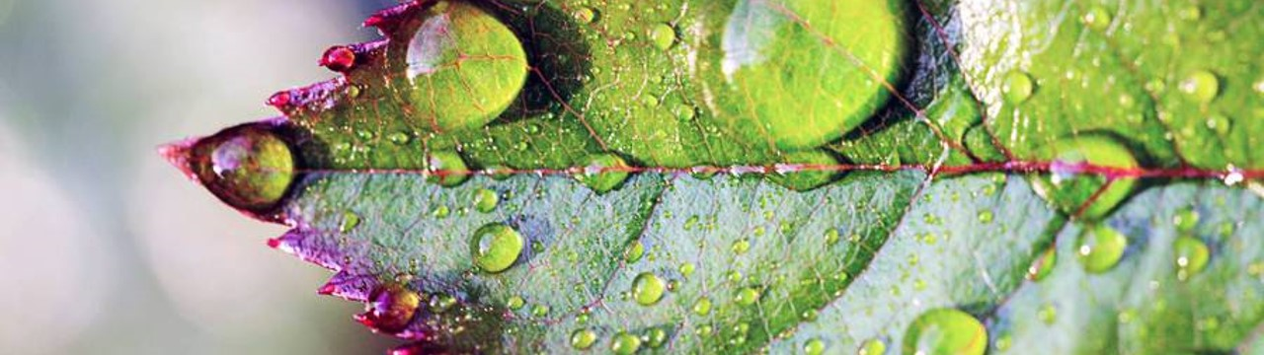
Conclusion
Random Forest Classifier is the selected model that is best applicable to the data set as a ML model

Slide 7
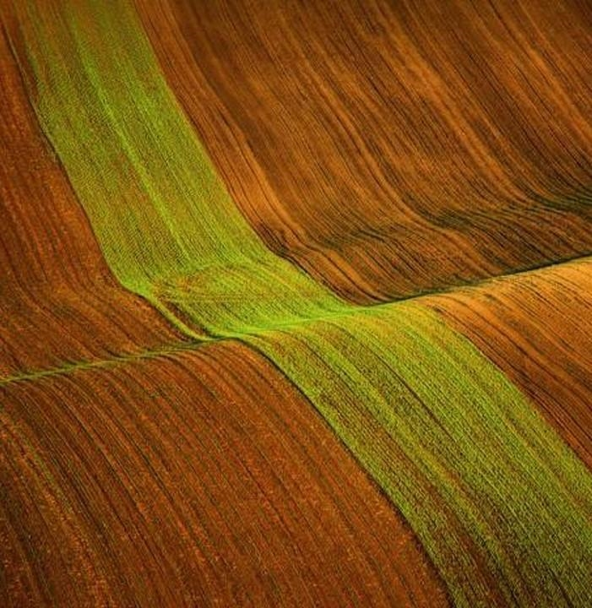
Thank you
saumya.gunawardana@dialog.lk

